Slide 1

Automated Feedback Analysis Workflow
Kunal Gaurav
AI Automation | Project 3

Slide 2
Introduction
The goal of this project is :
Provide a google form to the customer to get feedback
2 questions are asked
The answers are given to Google Gemini AI module that uses AI to get the Sentiment of the customer and also make a Summary of the customer feedback
The Sentiment and Summary are converted to a JSON format.
The JSON format is fed to the google sheet(that stores the customer feedback) in 2 added columns of “Sentiment” and “Summary”
If the customer feedback is negative, a mail is sent to the admin informing the admin about the negative feedback.

Slide 3
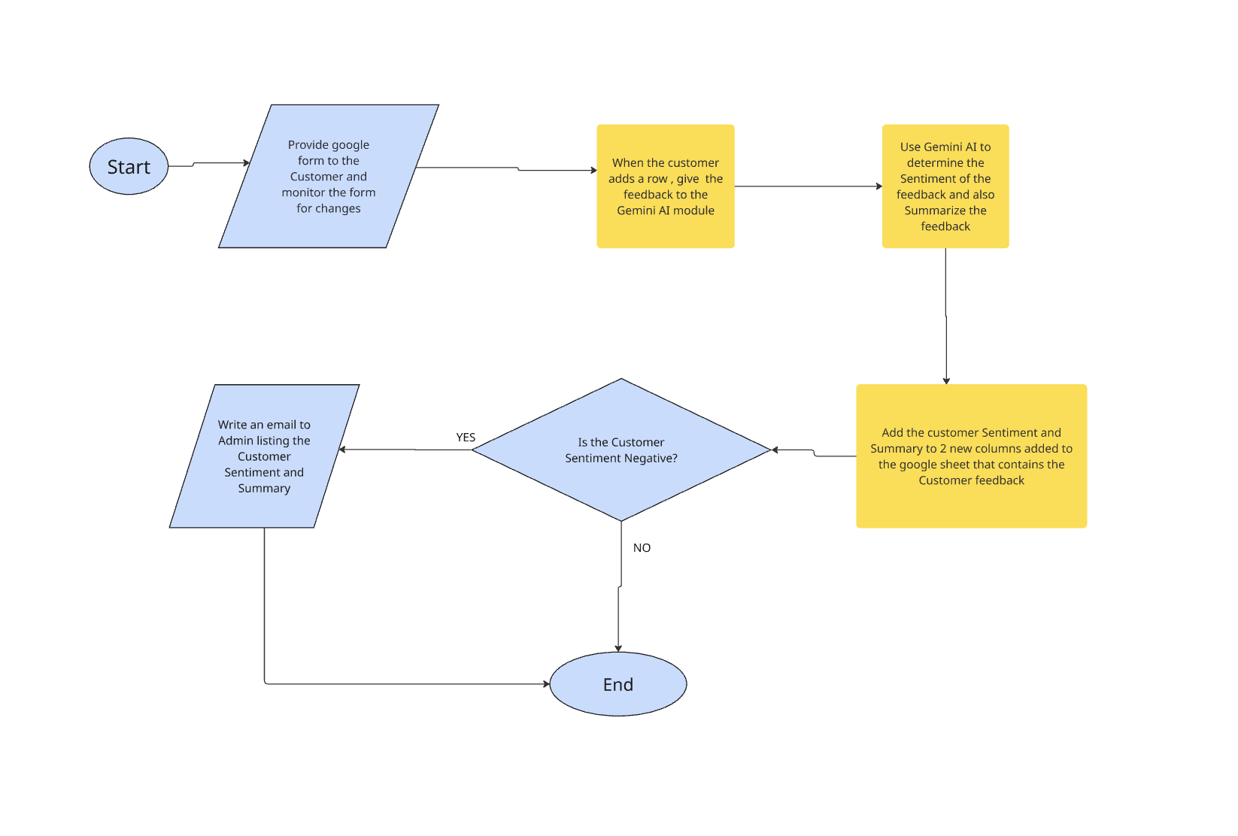
Customer Feedback Workflow diagram

Slide 4
Customer Feedback Workflow in action
The google form used to take the Customer input is here:
https://docs.google.com/forms/d/e/1FAIpQLScg7Oh5g_V_0u4EFi2SppjfG83hrgBw-gNWdmC1cAe-4re6Eg/viewform
The Make scenario that runs the feedback logic is here: https://us2.make.com/public/shared-scenario/dOc5dc0HQW0/automation-feedback-customer
The JSON blueprint of the Make scenario is here:
https://drive.google.com/file/d/18hMKlGHmDA8SzSAc62l7f3zBKbeC70yQ/view?usp=sharing
The google sheet with the test data is here:
https://docs.google.com/spreadsheets/d/1-Gk9DpBHr8CDscm9T4DnkPqVu42G95c22qVqHnaXlTU/edit?usp=sharing

Slide 5
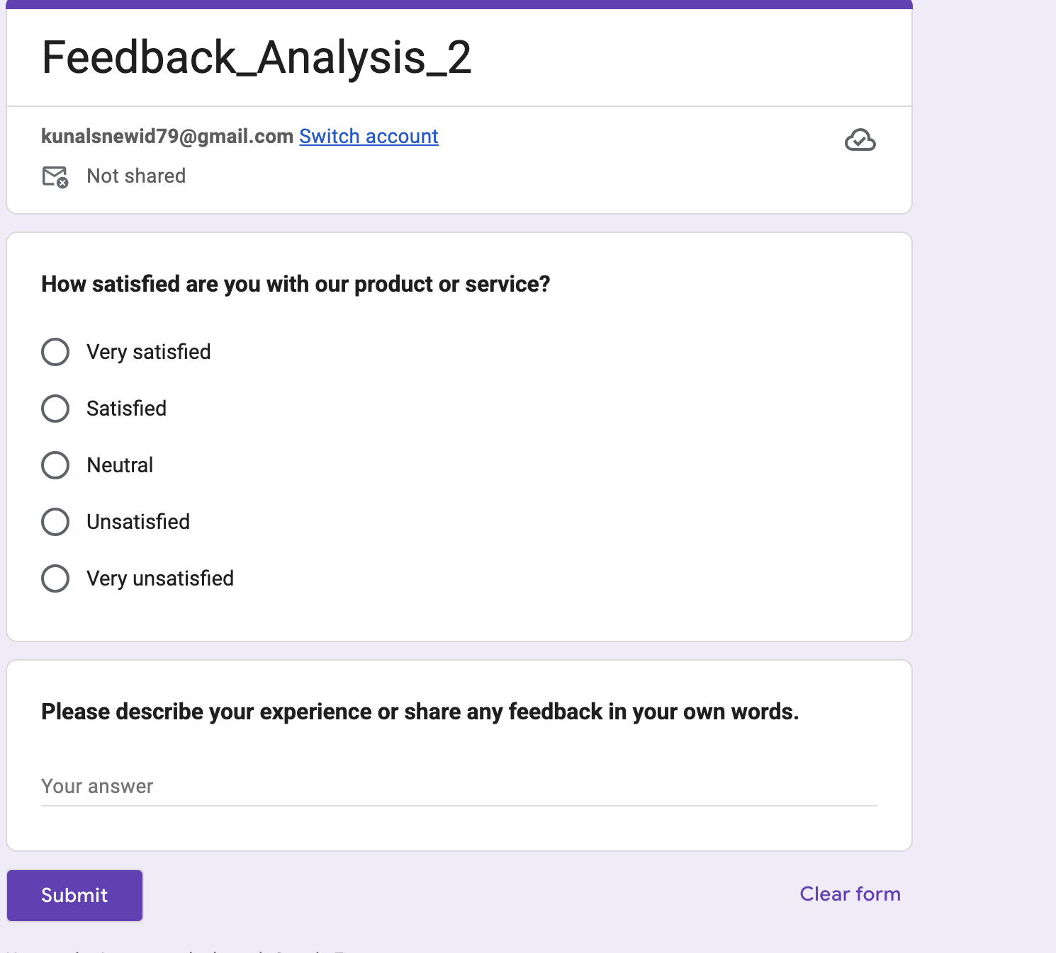
Snapshot of the Google form:

Slide 6
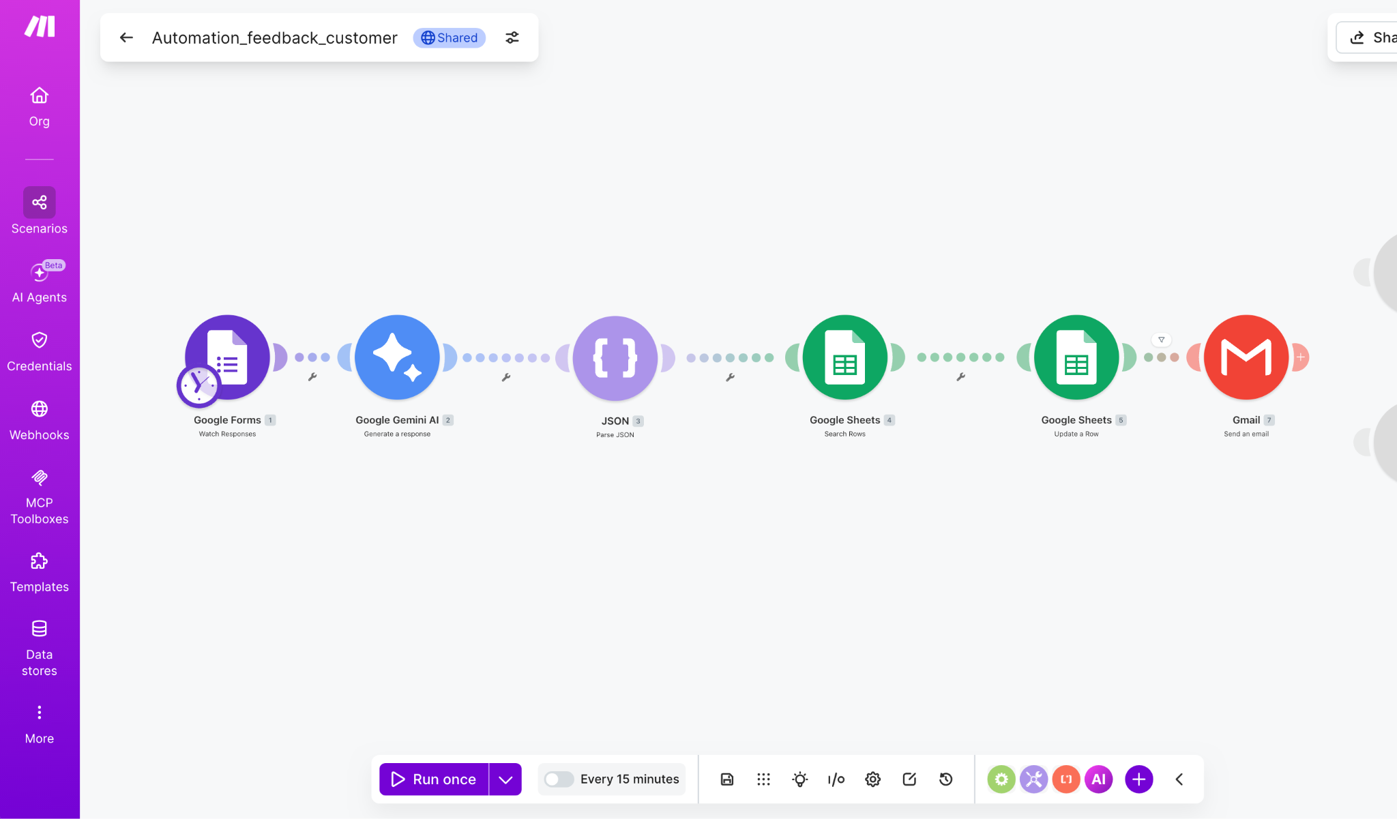
Snapshot of the Make scenario

Slide 7
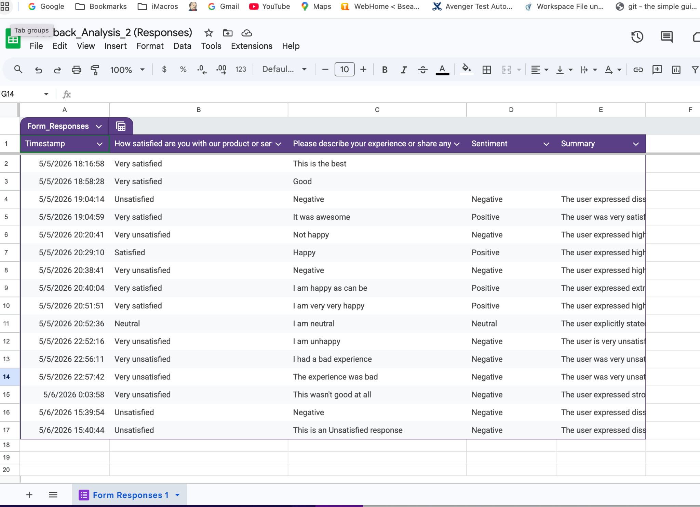
Snapshot of the google sheet with the Test Data
The snapshot of the google sheet with added “Sentiment” and “Summary” columns is below:

Slide 8
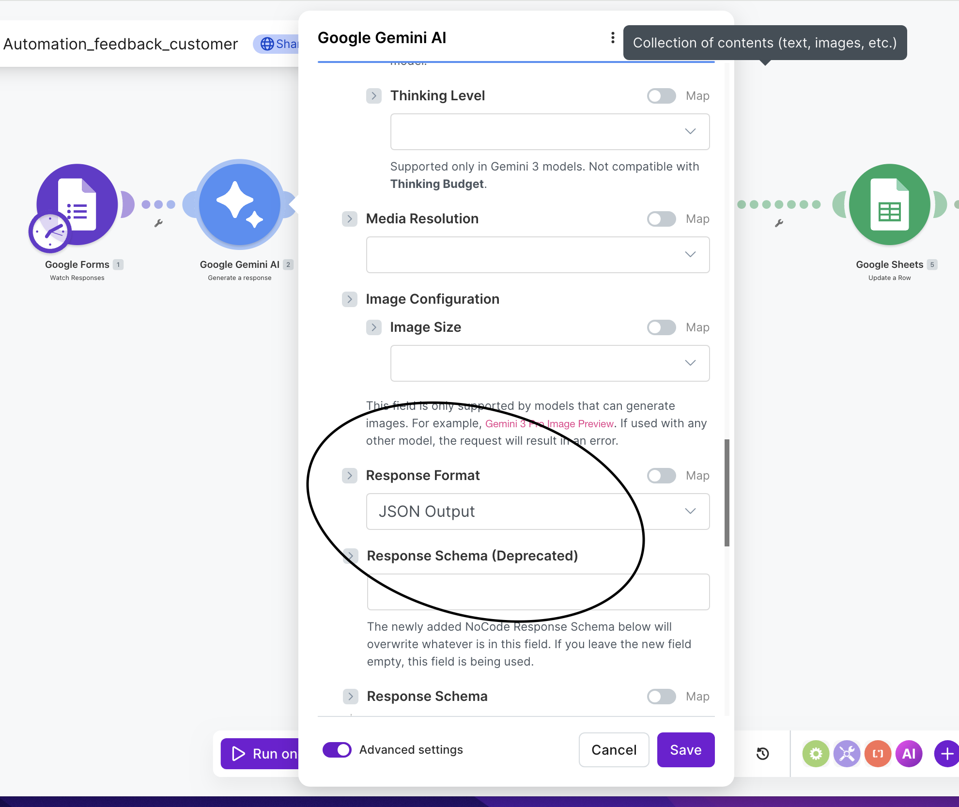
Important Make Modules
The Google Gemini AI module is important because it uses AI to determine the Customer’s Sentiment and Summary. It also uses the “Advanced Setting” of “Response Format” as JSON, without which the JSON parsing module will fail. A snapshot of the module is below:

Slide 9
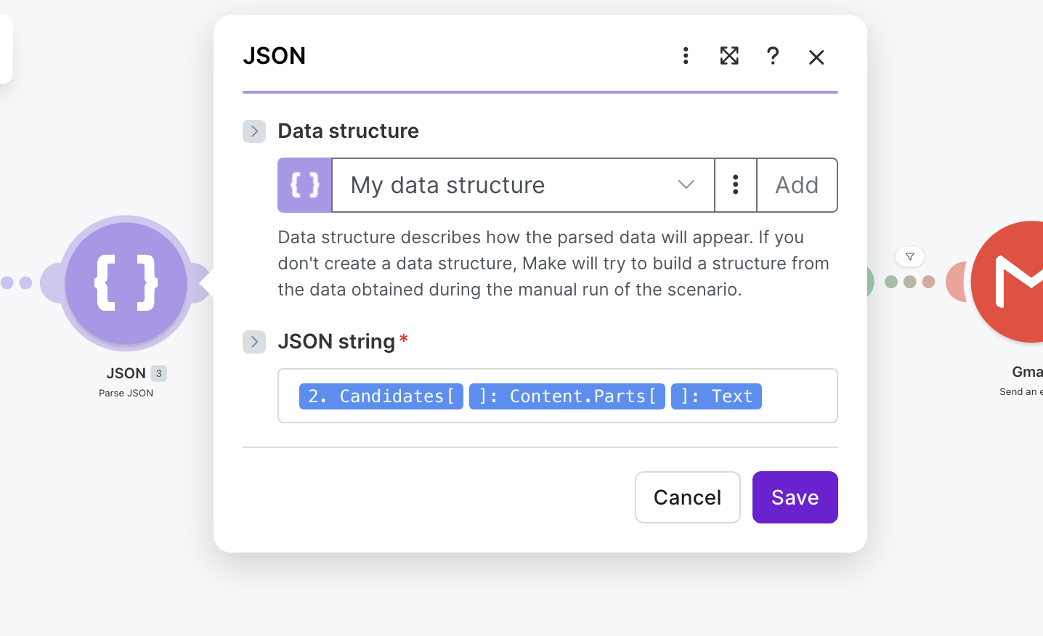
The other important Module is the JSON parsing module.
It takes the input from Google AI Gemini module and parses the input into JSON which is used to update the Customer Feedback Google sheet. A snapshot of the JSON module is below:

Slide 10
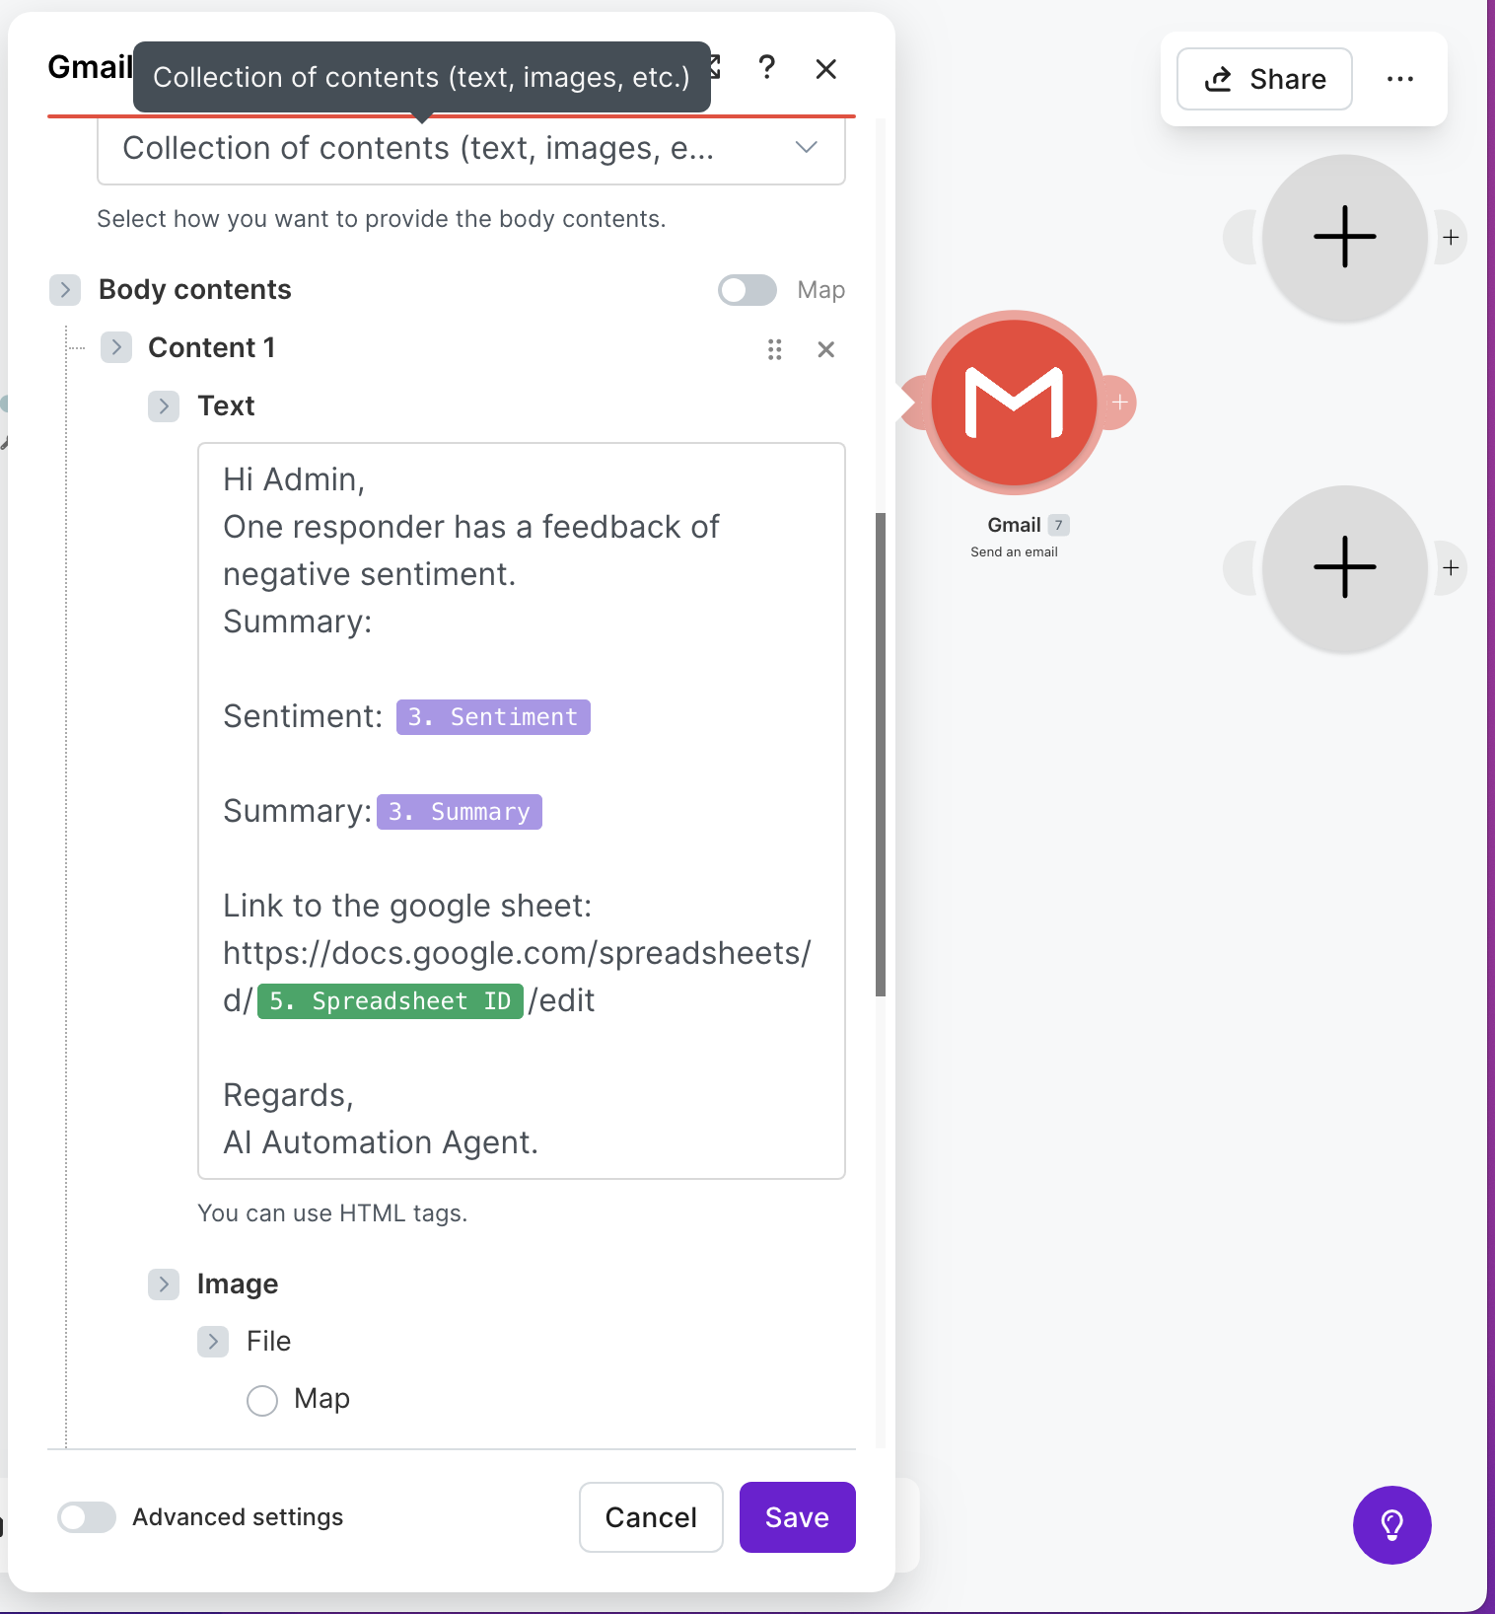
Email alert for Negative Sentiment
An email alert is sent out if the Customer’s sentiment is negative.
The snapshot of the optional email alert is below:

Slide 11
Challenges and Improvements
Challenge:
The Make scenario worked smoothly with the Google Gemini AI.
However, the JSON parser was throwing an error because the Google Gemini AI module was not giving it pure JSON data. To fix this I finally found the “Advanced Setting” of “Response Format” that sets the output data to JSON.
Improvements:
The form used for Customer’s response had only 2 questions. A more elaborate form could be used to get more input from the Customer about the product or service
The product or service could have been divided into more modules and feedback for those modules could have enhanced the data we were getting
The AI logic in the Google Gemini module could have been similarly enhanced to give more feedback about the product or service by analysing the different modules of the product or service. The prompt for the AI module could have been more elaborate

